Slide 1
Wi-Fi Management and Security
|
|
|
|
|
L2 Network

Slide 2
Module 2
Module 2 will be covering the following topics: How to Find the Best Wi-Fi ONU router Placement?
Guidelines for Finding the Best Placement for a Wi-Fi ONU router:
1. Make Your ONU the Center of Attention
2. Get Your ONU Off the Floor
3. Avoid Physical Obstacles
4. Be on the Lookout for Interference
5. Reposition Your ONU’s Antennas
6. Bonus: Update Your ONU.
What are Some Other Ways to Boost Wi-Fi?
Check Your Wi-Fi Signal Strength.

Slide 3
How to Find the Best Wi-Fi ONU Router Placement?
Take into consideration
Physical obstacles
Layout of the area
Look for potential interference in the spectrum.

Slide 4
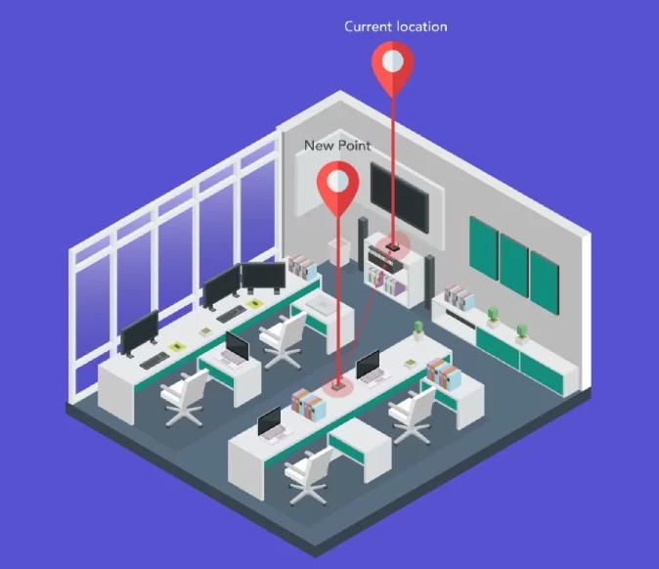
Guidelines for Finding the Best Placement
Make Your Router the Center of Attention.
*Move it to Central Location.
Example 1

Slide 5
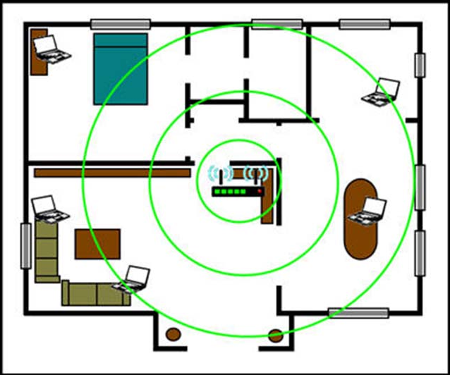
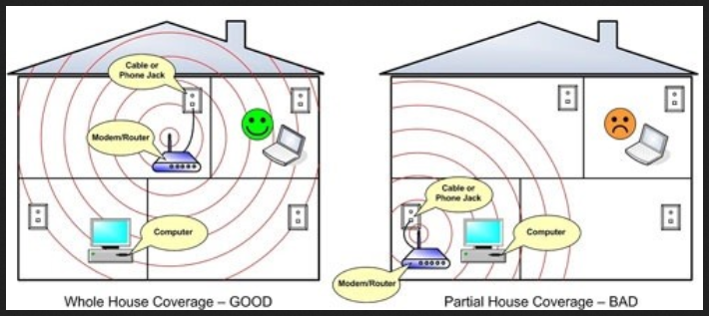
1. Make Your Router the Center of Attention
Example 2
Always find the Center Point of the area layout

Slide 6
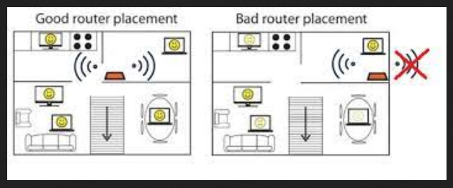
1. Make Your Router the Center of Attention
Example 3

Slide 7
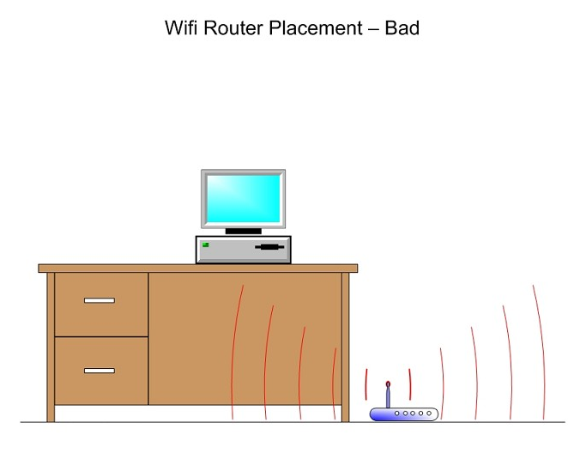
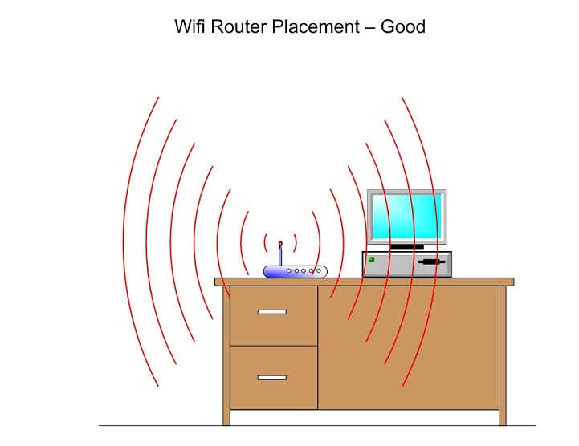
2. Get Your ONU Router Off the Floor
Example 1
Do not setup router on the base of the House

Slide 8
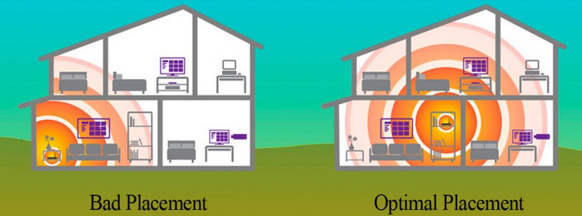
2. Get Your ONU Router Off the Floor
Example 2
Do not setup router on the base of the House

Slide 9
3. Avoid Physical Obstacles
Such as cabinets and large appliances.
Reflective surfaces can bounce off Wi-Fi signals,
Will cause performance issues.

Slide 10
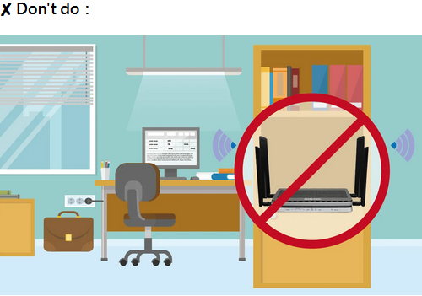
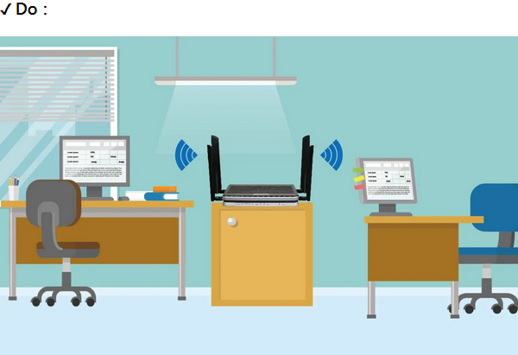
3. Avoid Physical Obstacles
Example 1
Do not put the router in a cabinet
Keep the router out in the open

Slide 11
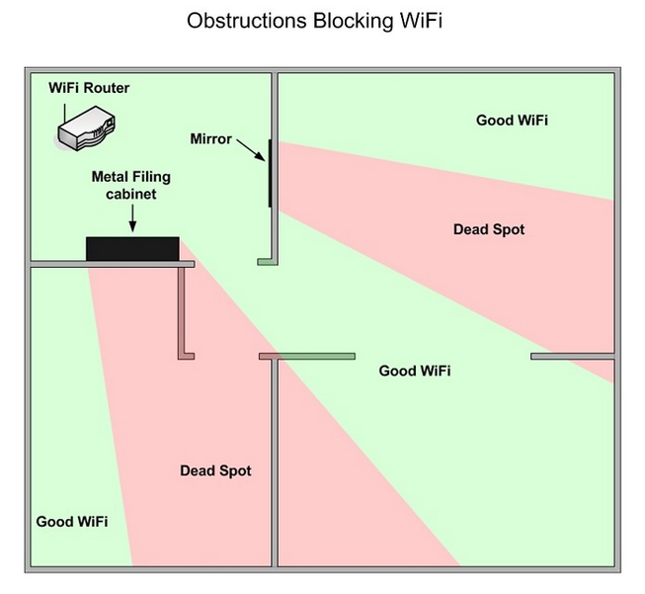
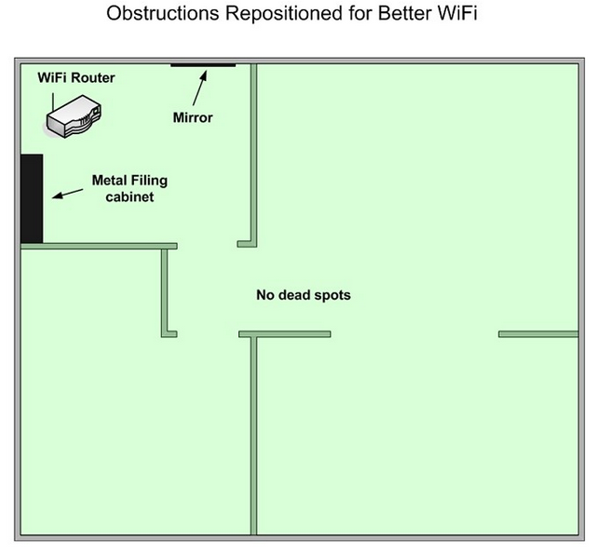
3. Avoid Physical Obstacles
Example 2

Slide 12
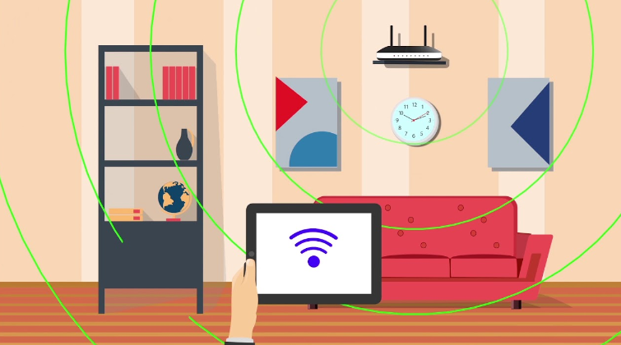
3. Avoid Physical Obstacles
Example 3
Find the Best place and Keep the router out in the open

Slide 13
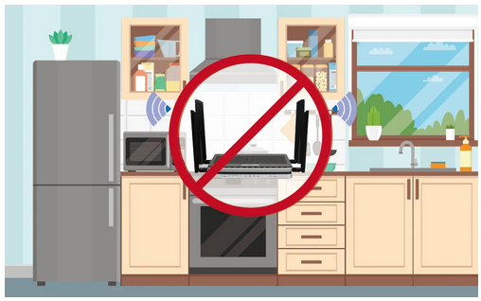
3. Avoid Physical Obstacles
Example 4
Bathrooms/Kitchens are not recommended areas to place routers.

Slide 14
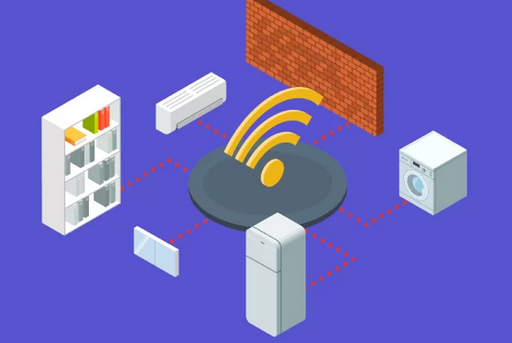
3. Avoid Physical Obstacles
Example 5
Go through the surrounding objects and avoid the obstacles

Slide 15
4. Be on the Lookout for Interference
Channel Overlap
Avoid devices like,
Microwave ovens
Monitors
Wireless security cameras
Cordless phones
and various smart home devices

Slide 16
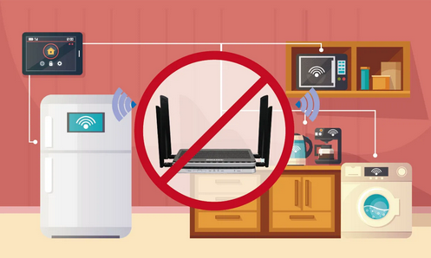
4. Be on the Lookout for Interference
Example 1
Keep the router away from other electronics

Slide 17
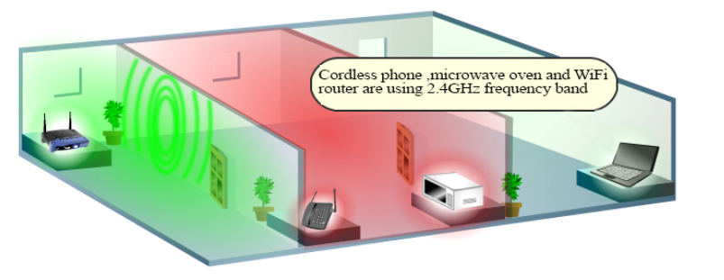
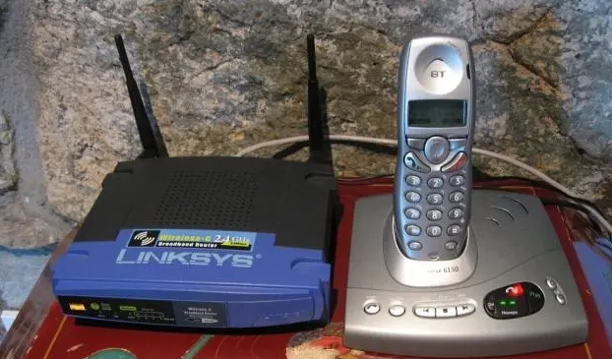
4. Be on the Lookout for Interference
Example 2
Do Not Place router close other smart electronics Devices.

Slide 18
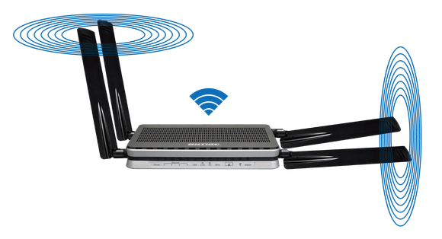
5. Reposition Your Router’s Antennas
Router with adjustable antennas, experiment with their position to improve the quality of your Wi-Fi signal.
Reposition antennas and experiment with their position to improve Signal.

Slide 19
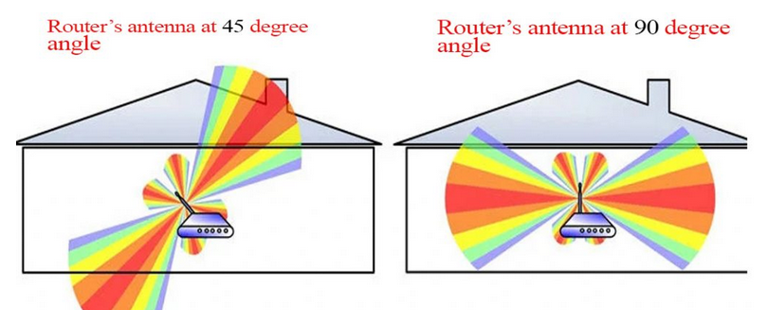
5. Reposition Your Router’s Antennas
Example 1
How the signal is being distributed

Slide 20
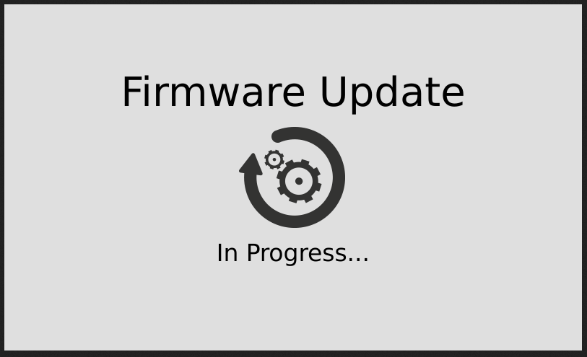
6. Bonus: Update Your ONU / Router
Check for updates and Install available updates.

Slide 21
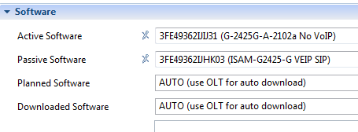
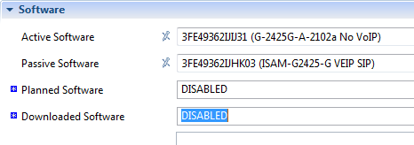
6. Bonus: Update Your ONU
Example
Do not provision ONT with disabled option for every Nokia ONT.

Slide 22
What are Some Other Ways to Boost Wi-Fi?
Improve your Wi-Fi security settings.
Control bandwidth-hungry applications.
Upgrade your Wi-Fi network.

Slide 23
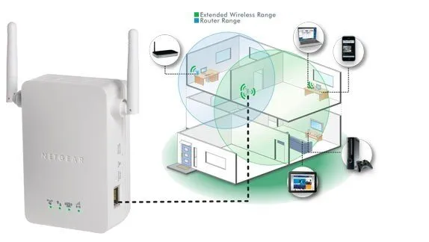
Upgrade your Wi-Fi network
Wi-Fi Booster

Slide 24
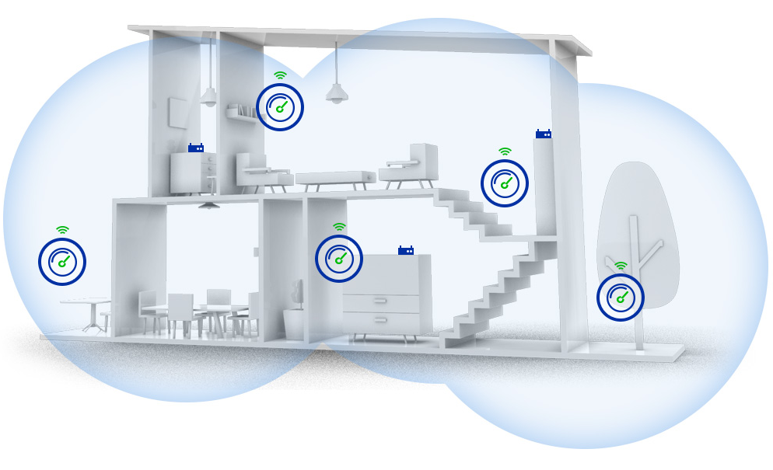
Upgrade your Wi-Fi network
Mesh Router “Nokia Beacon, Google Wi-Fi, TP-link Deco Mesh”

Slide 25
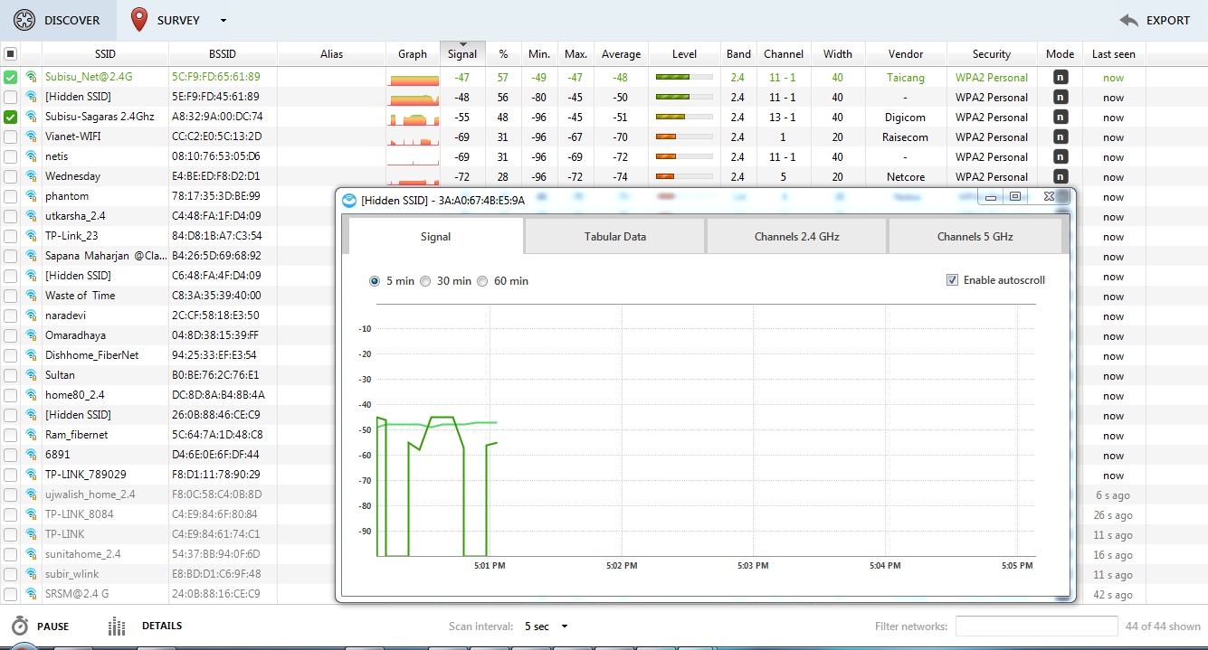
Check Your Wi-Fi Signal Strength
Check Wi-Fi signal strength using several analyzer tools “Netspot, Inssider, etc”.
Example 1 Tool: Netspot

Slide 26
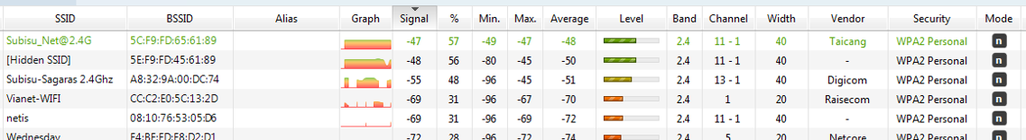
Check Your Wi-Fi Signal Strength
Check your Wi-Fi channel and prevent channels overlap
Verify SSID
Verify your RSSI
Example 2 Tool: Netspot

Slide 27
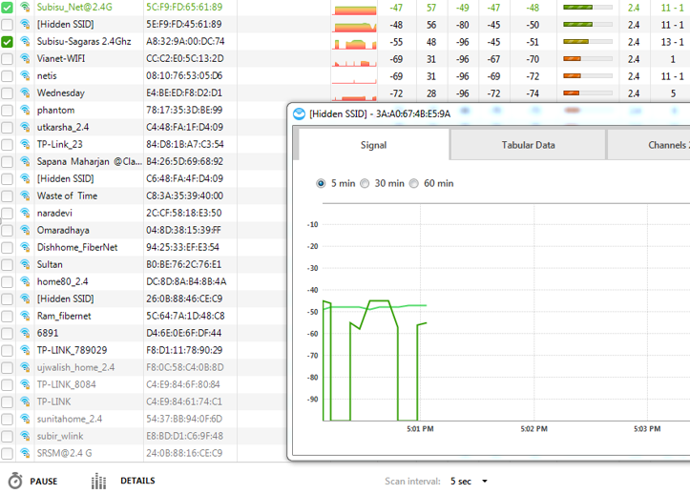
<< Check for overlapping channels
Example 3
Use Wi-Fi Analyzer Tool
<< Verify RSSI strength

Slide 28
End of Module 2
Thank You

Slide 29
Module 3
Module 3 will be covering the following topics:
Configuration and Troubleshooting
Wireless configuration
Wi-Fi Troubleshooting “Better Performance”
Introduction to Mesh Wi-Fi Router “Nokia Beacon”
Nokia Recommended Placement
Beacon Installation

Slide 30
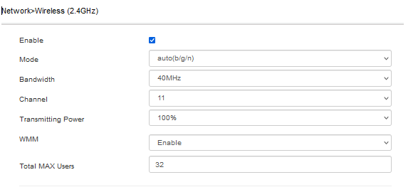
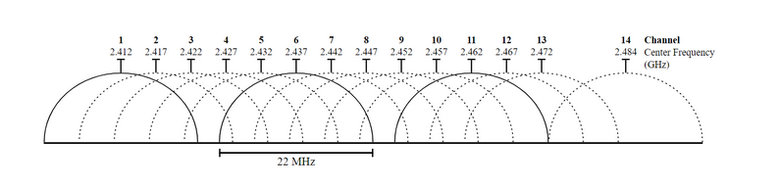
Configuration and Troubleshooting
Nokia Wi-Fi ONU ”2.4GHz”
Wireless Interface enable/disable
802.11 Standard
Channel Range
Wi-Fi Channel for transmission
Antenna Power
Wireless Multimedia for QoS
Client Limit

Slide 31
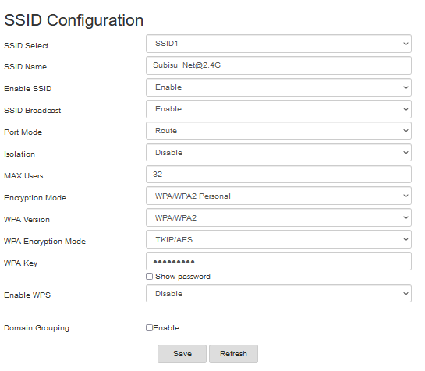
Nokia Wi-Fi ONU
“Service Set Identifier”
Support Multiple SSID
Network Name
Enable Selected Network Name
Show Wi-Fi Name
Wireless interface mode Route / Bridge
Wireless Client Isolation “Useful for ”
Client Limit for selected network
Wireless Encryption
Wireless Encryption method according to selected version
Key for authentication
Wi-Fi Protected Setup
Routing Domain

Slide 32
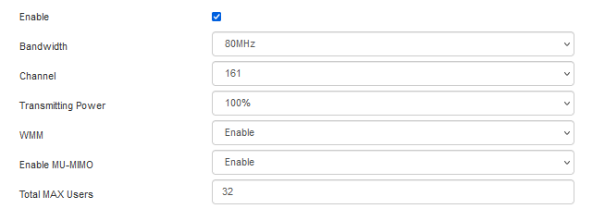
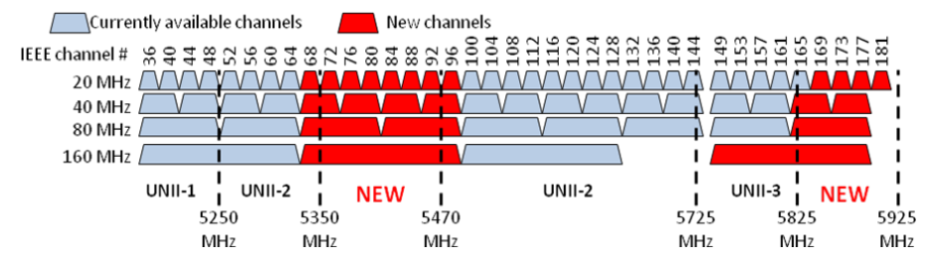
Nokia Wi-Fi ONU
Nokia Wi-Fi ONU ”5 GHz”
Wireless Interface enable/disable
Channel Range
Wi-Fi Channel for transmission
Antenna Power
Wireless Multimedia for QoS
MIMU technology
Client Limit

Slide 33
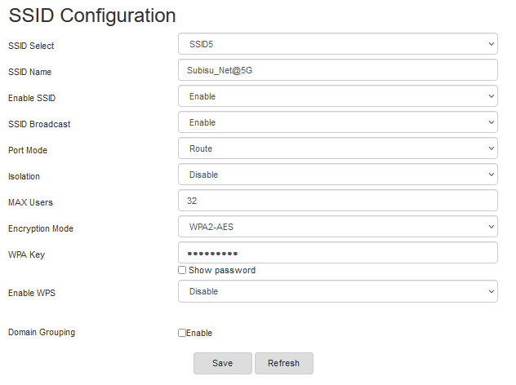
Nokia Wi-Fi ONU
“Service Set Identifier”
Support Multiple SSID
Network Name
Enable Selected Network Name
Show Wi-Fi Name
Wireless interface mode Route / Bridge
Wireless Client Isolation “Useful for Open / Guest Network ”
Client Limit for selected network
Wireless Encryption method according to selected version
Key for authentication
Wi-Fi Protected Setup
Routing Domain

Slide 34
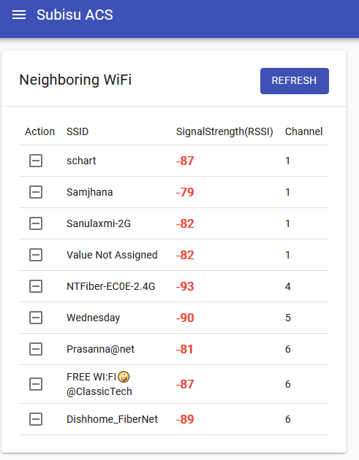
Wi-Fi Performance
Lookout for overlapping channels.
Verify the signal status of the other transmitting channels.

Slide 35
Wi-Fi Performance
Basic Service Set Identifier
Radio Signal Strength Indicator
Service Set Identifier
Transmitting channel
Encryption Method
Frequency Band
Channel width
Standard

Slide 36
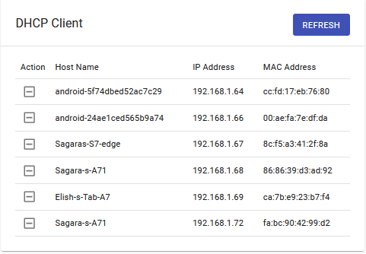
Wi-Fi Performance
Look for unexpected users

Slide 37
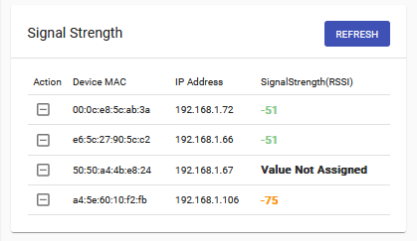
Wi-Fi Performance
Verify active devices and its signal strength.

Slide 38
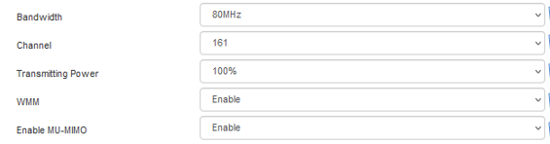
Wi-Fi Performance
Enable required Technologies and Features.
Use of channel width
WMM
MIMO
Standards

Slide 39
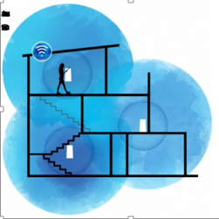
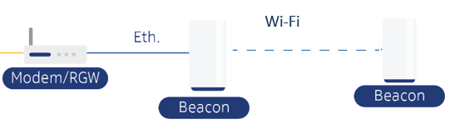
Introduction to Mesh Router Wi-Fi “Nokia Beacon”
Easy Plug and Play setup and implementation.
User friendly mobile app to play on mesh features.
Efficient channel and signal optimization.
Intelligent mesh routing.
Fast reconnection to AP.
Seamless Wi-Fi connection.
Reduced Wi-Fi interference.
Seamless Roaming feature.
Reduced Wi-Fi Dead Zones.

Slide 40

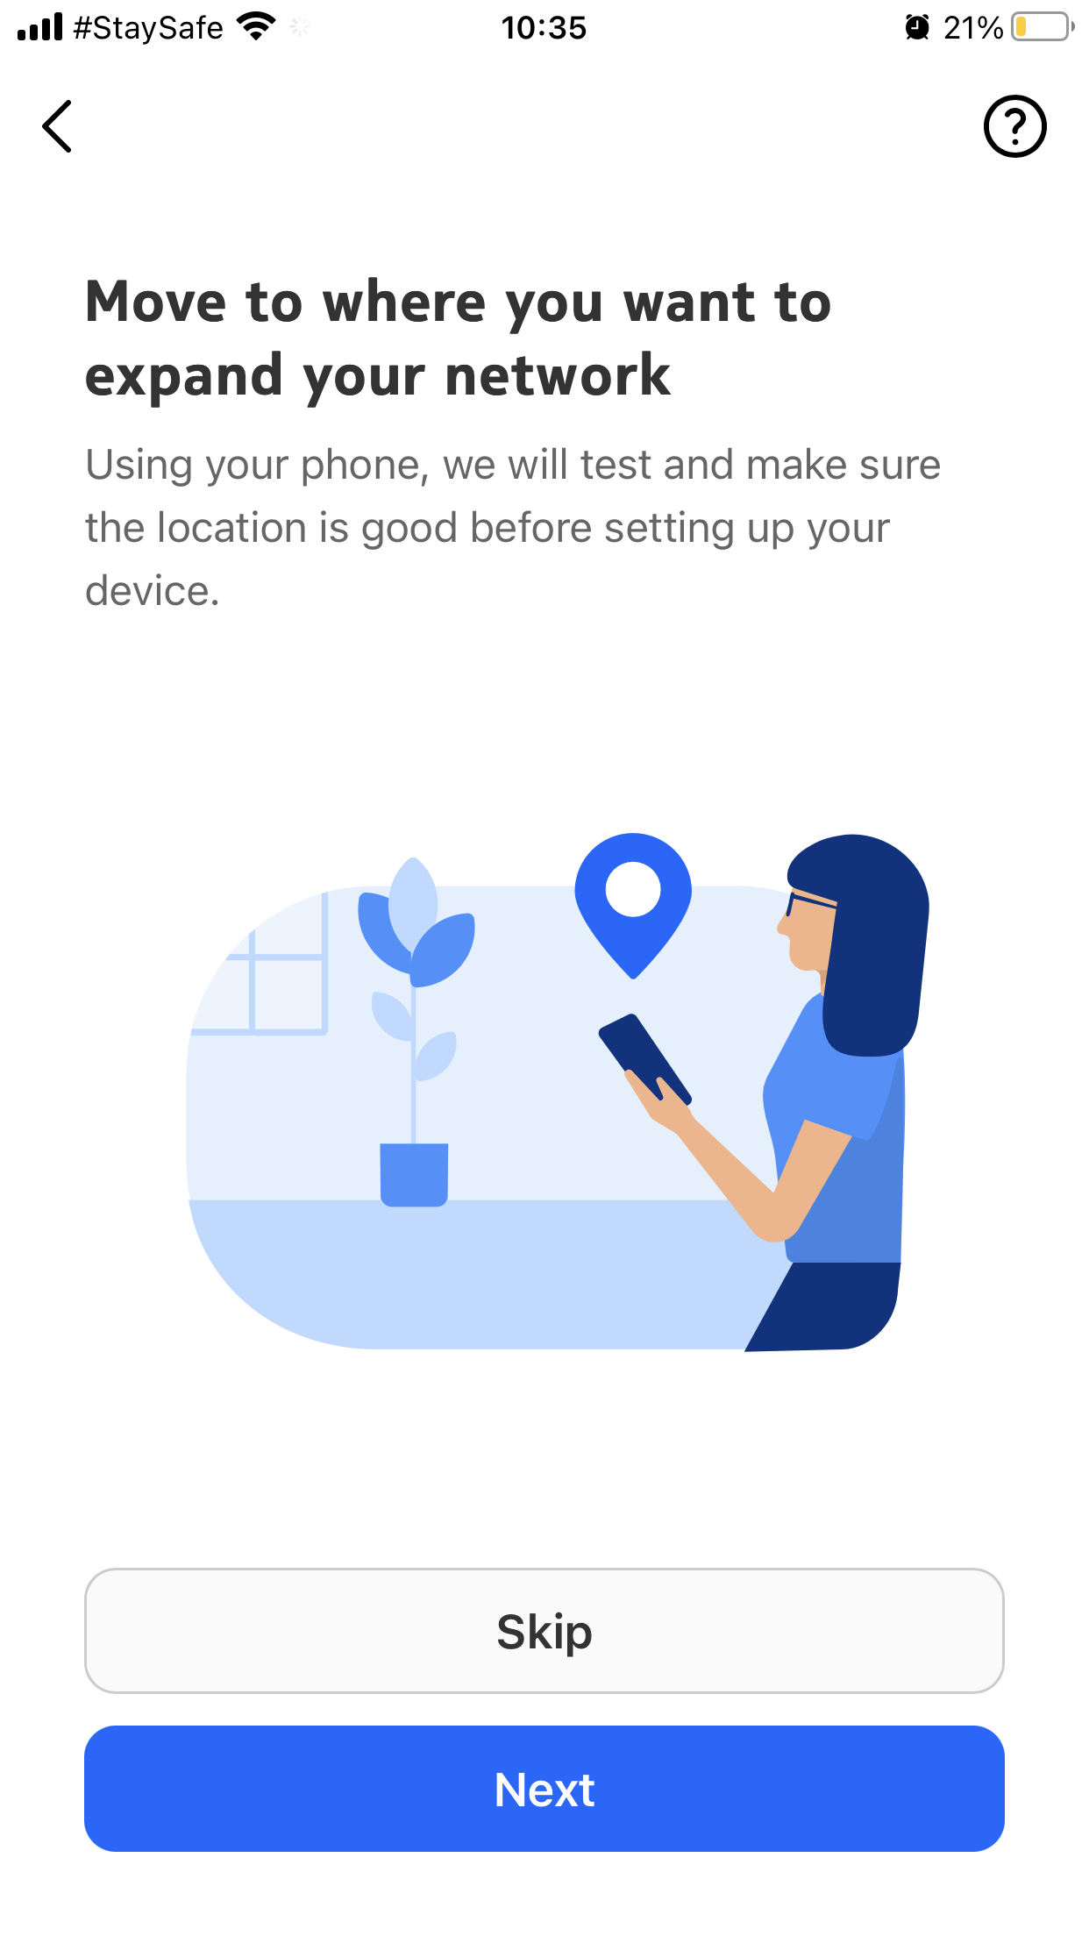
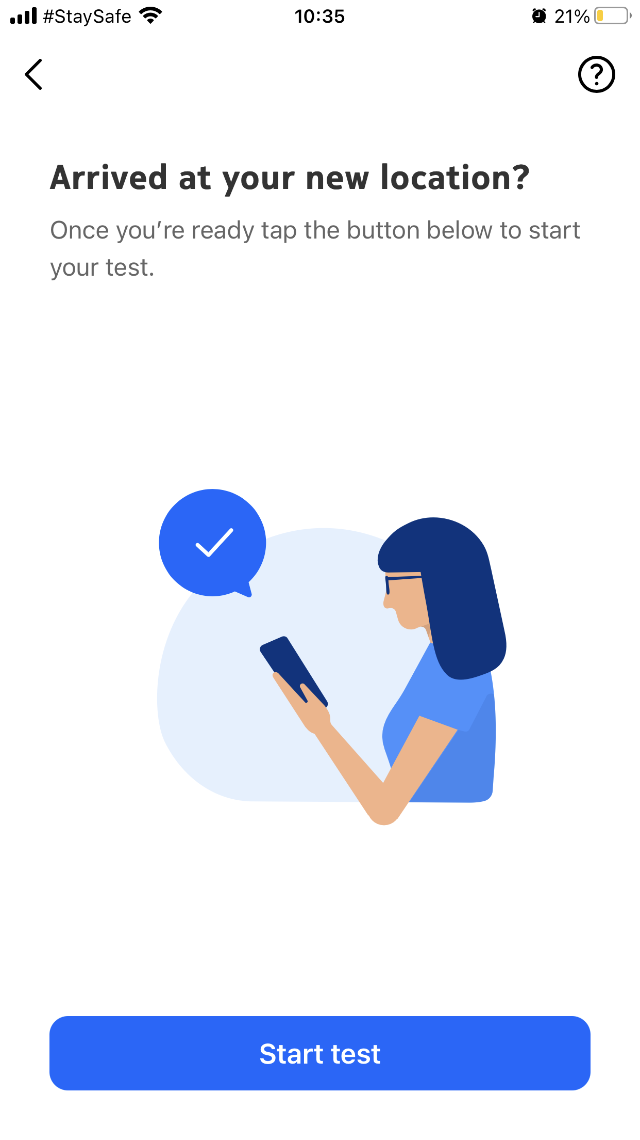
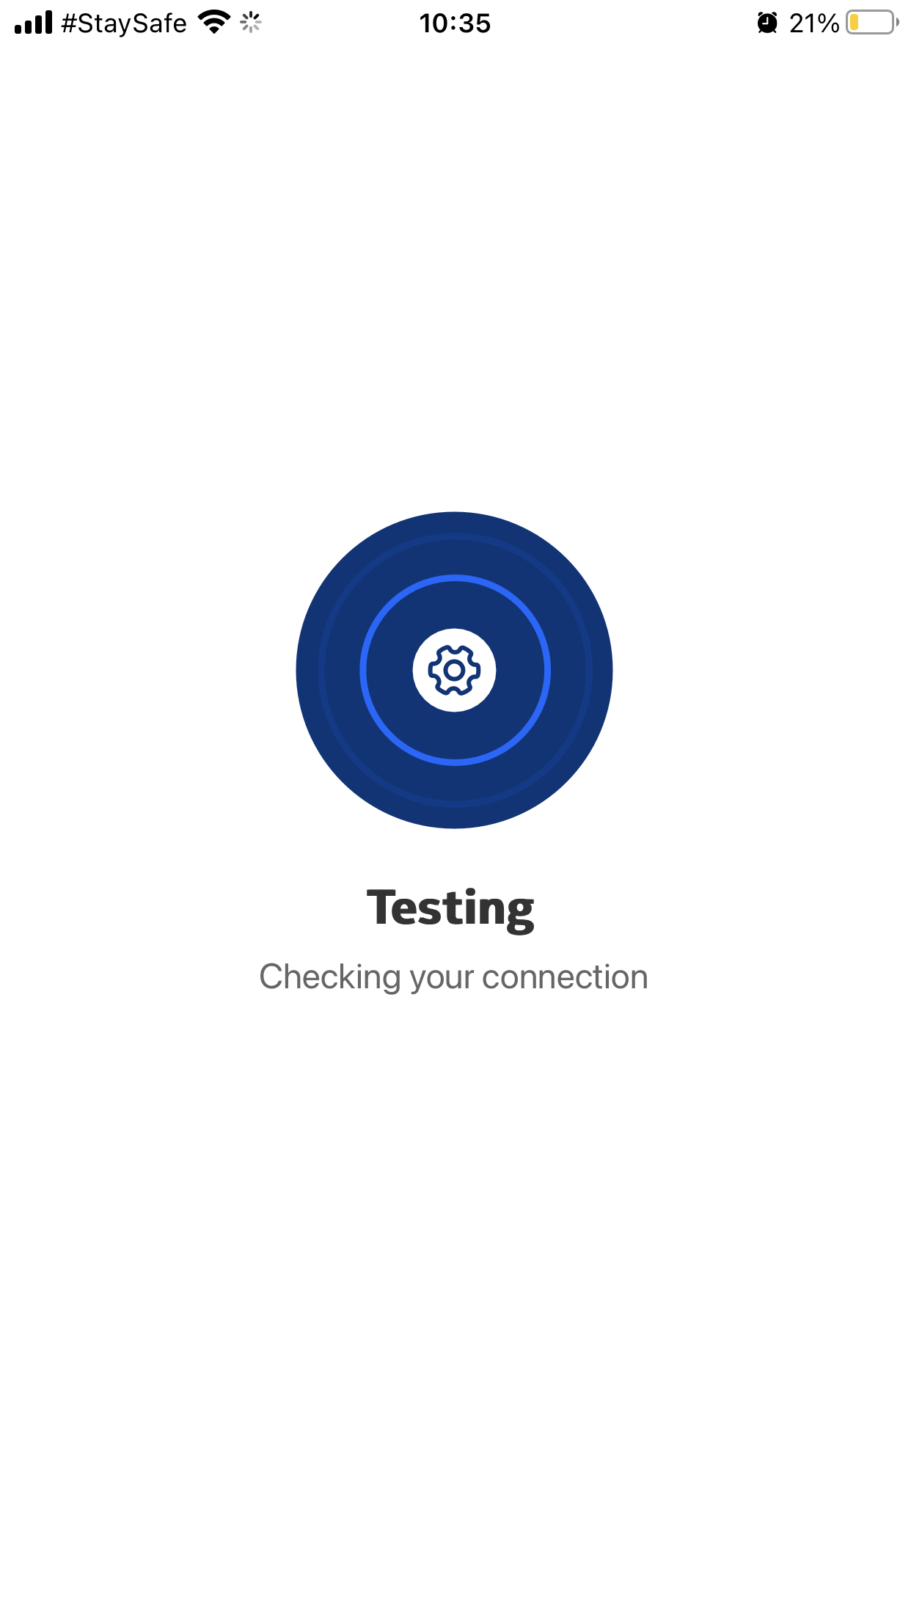
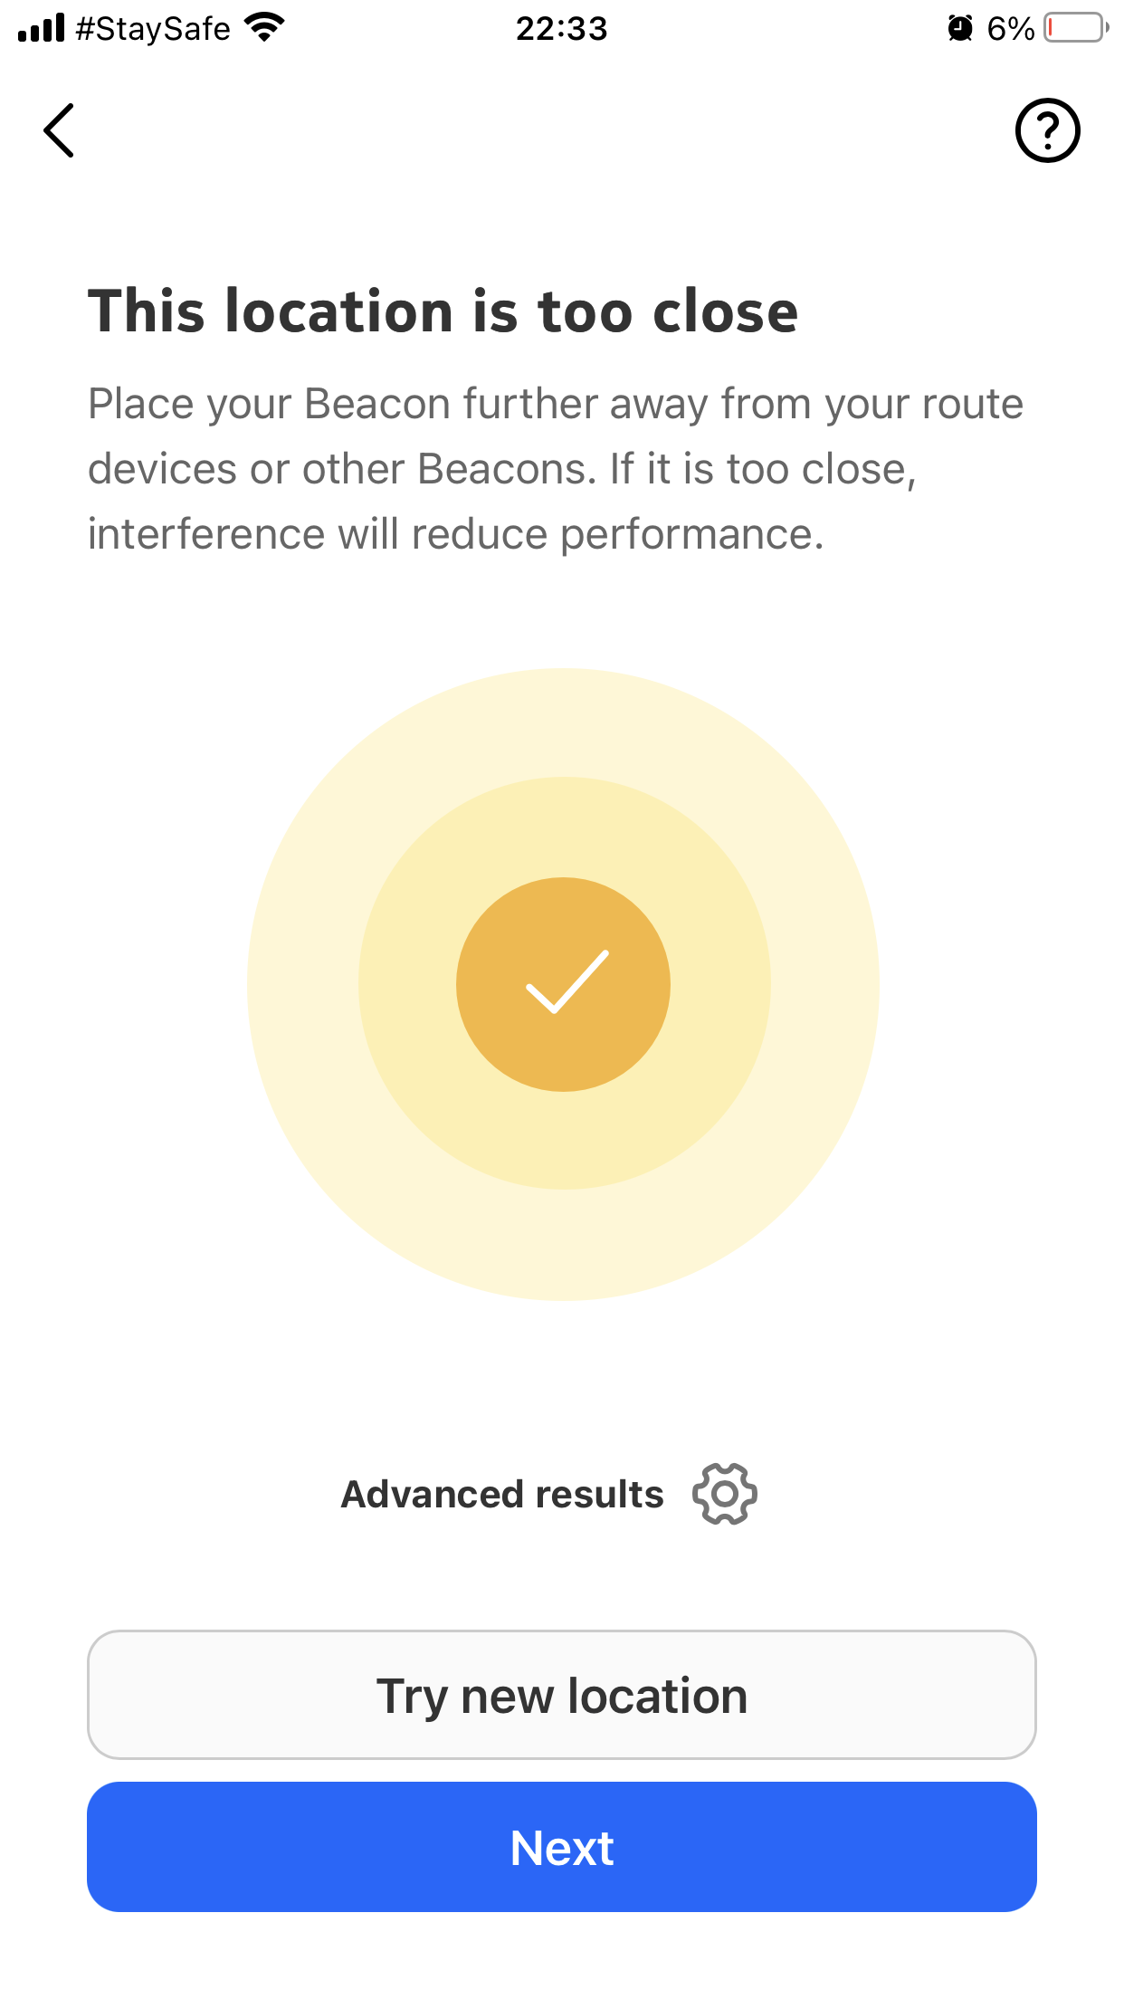
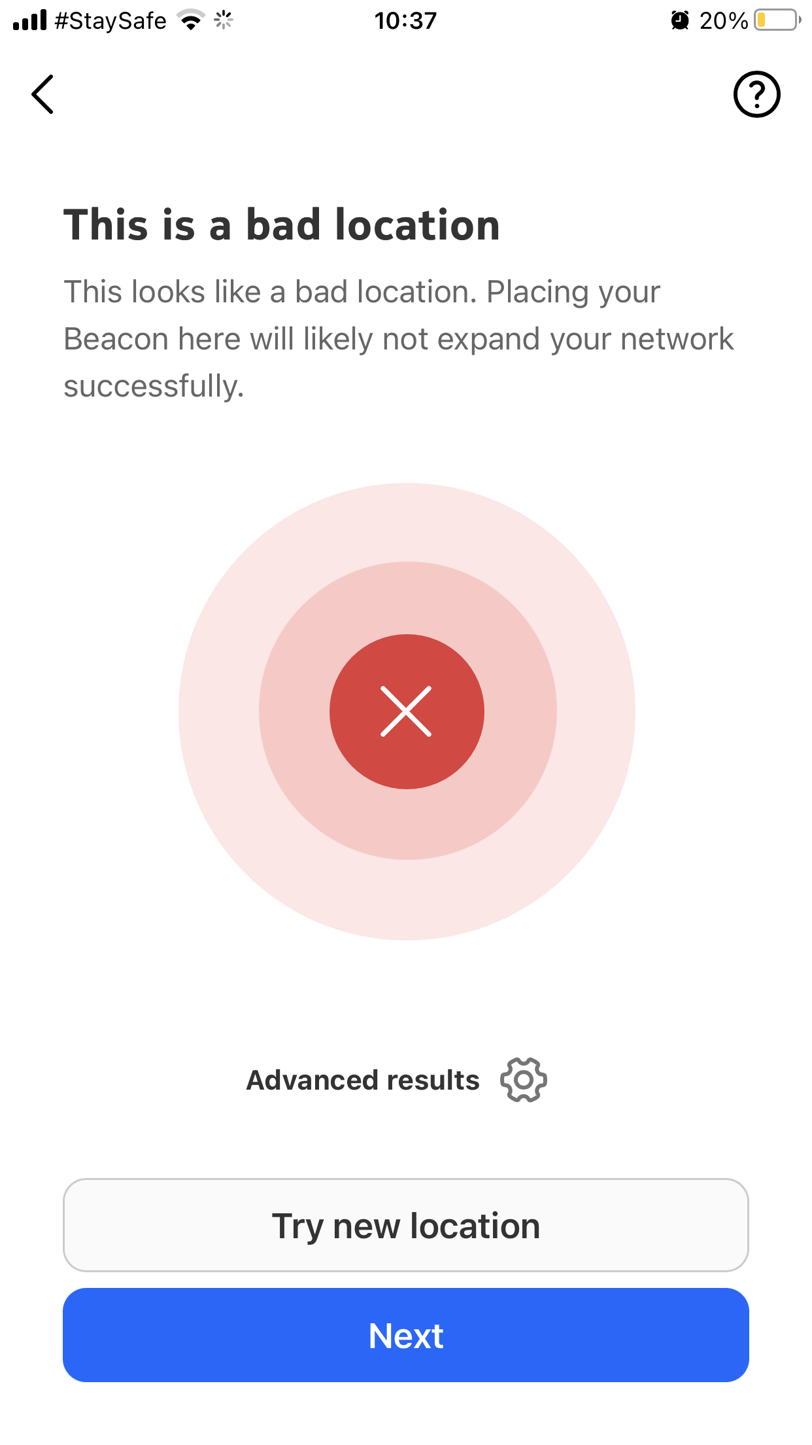
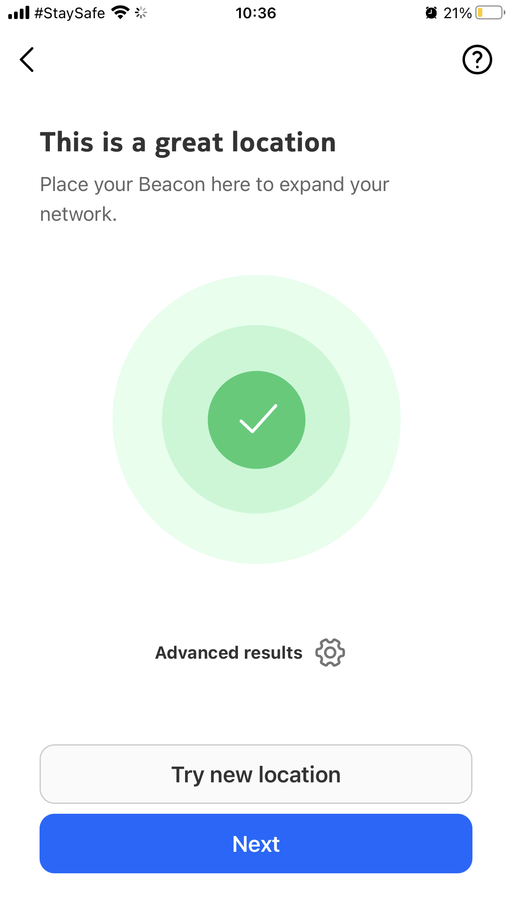
Nokia Recommended Placement
Using Phone to find suitable location.

Slide 41
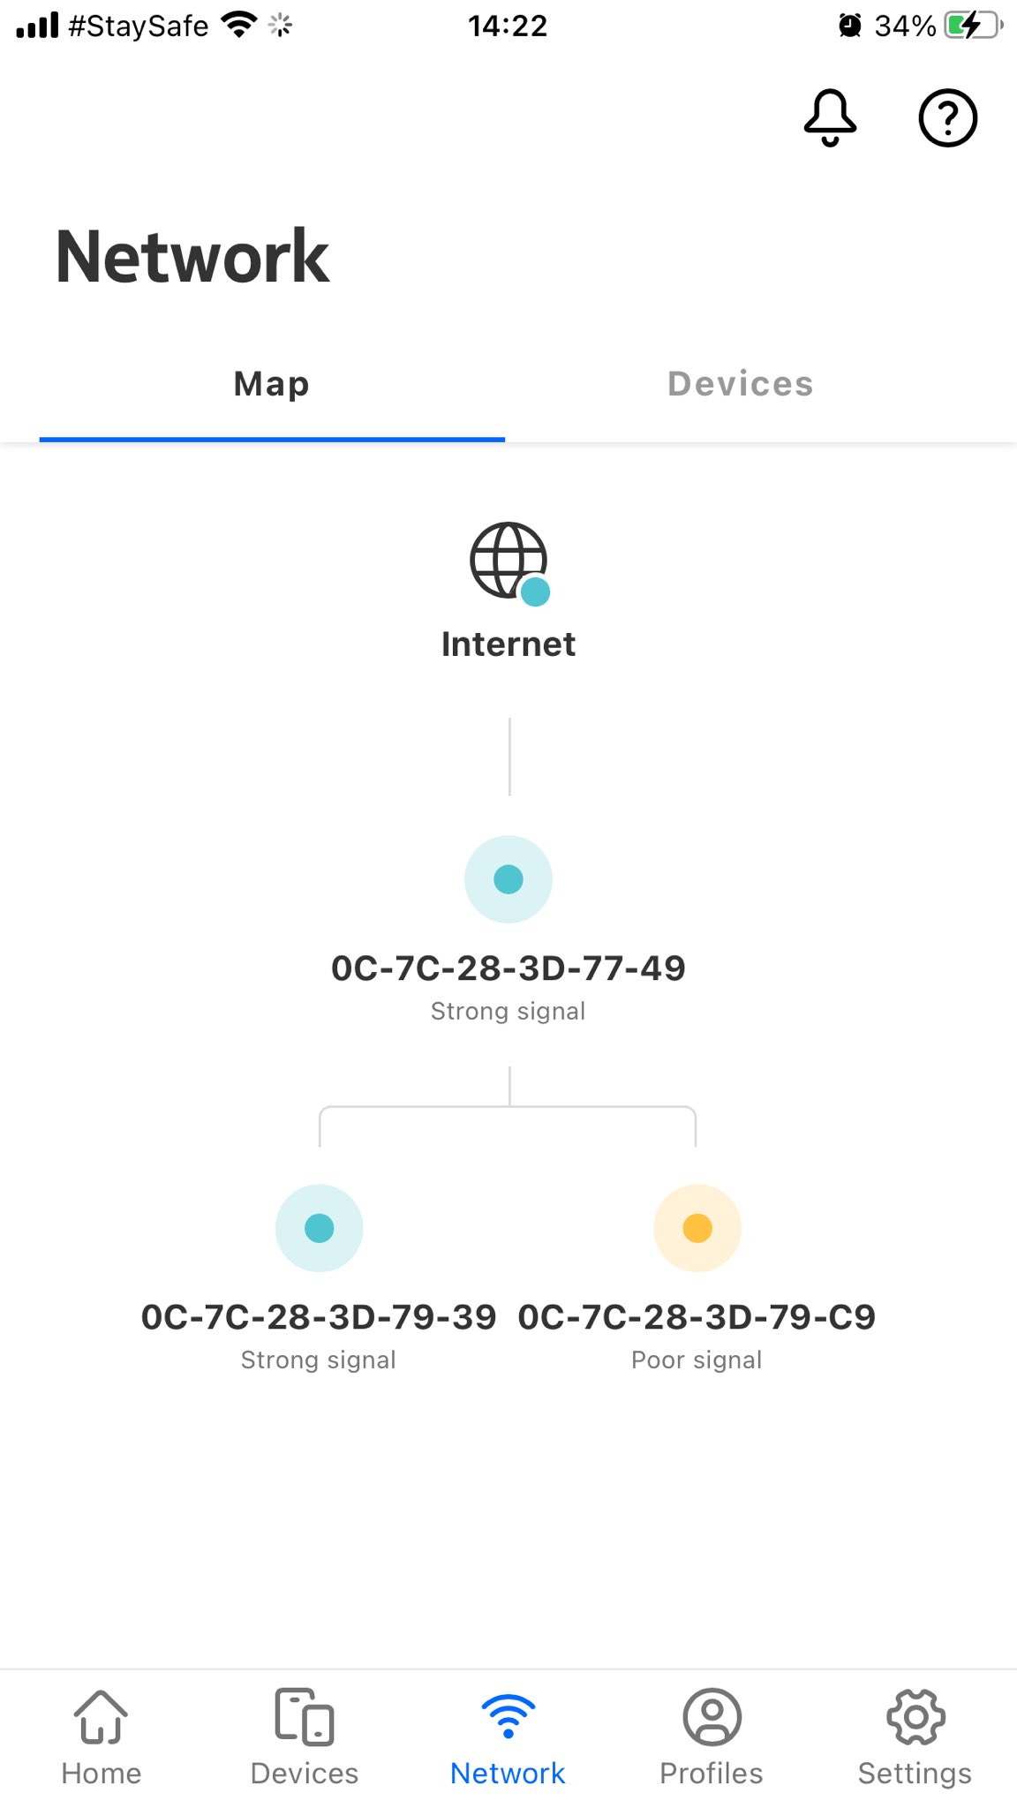
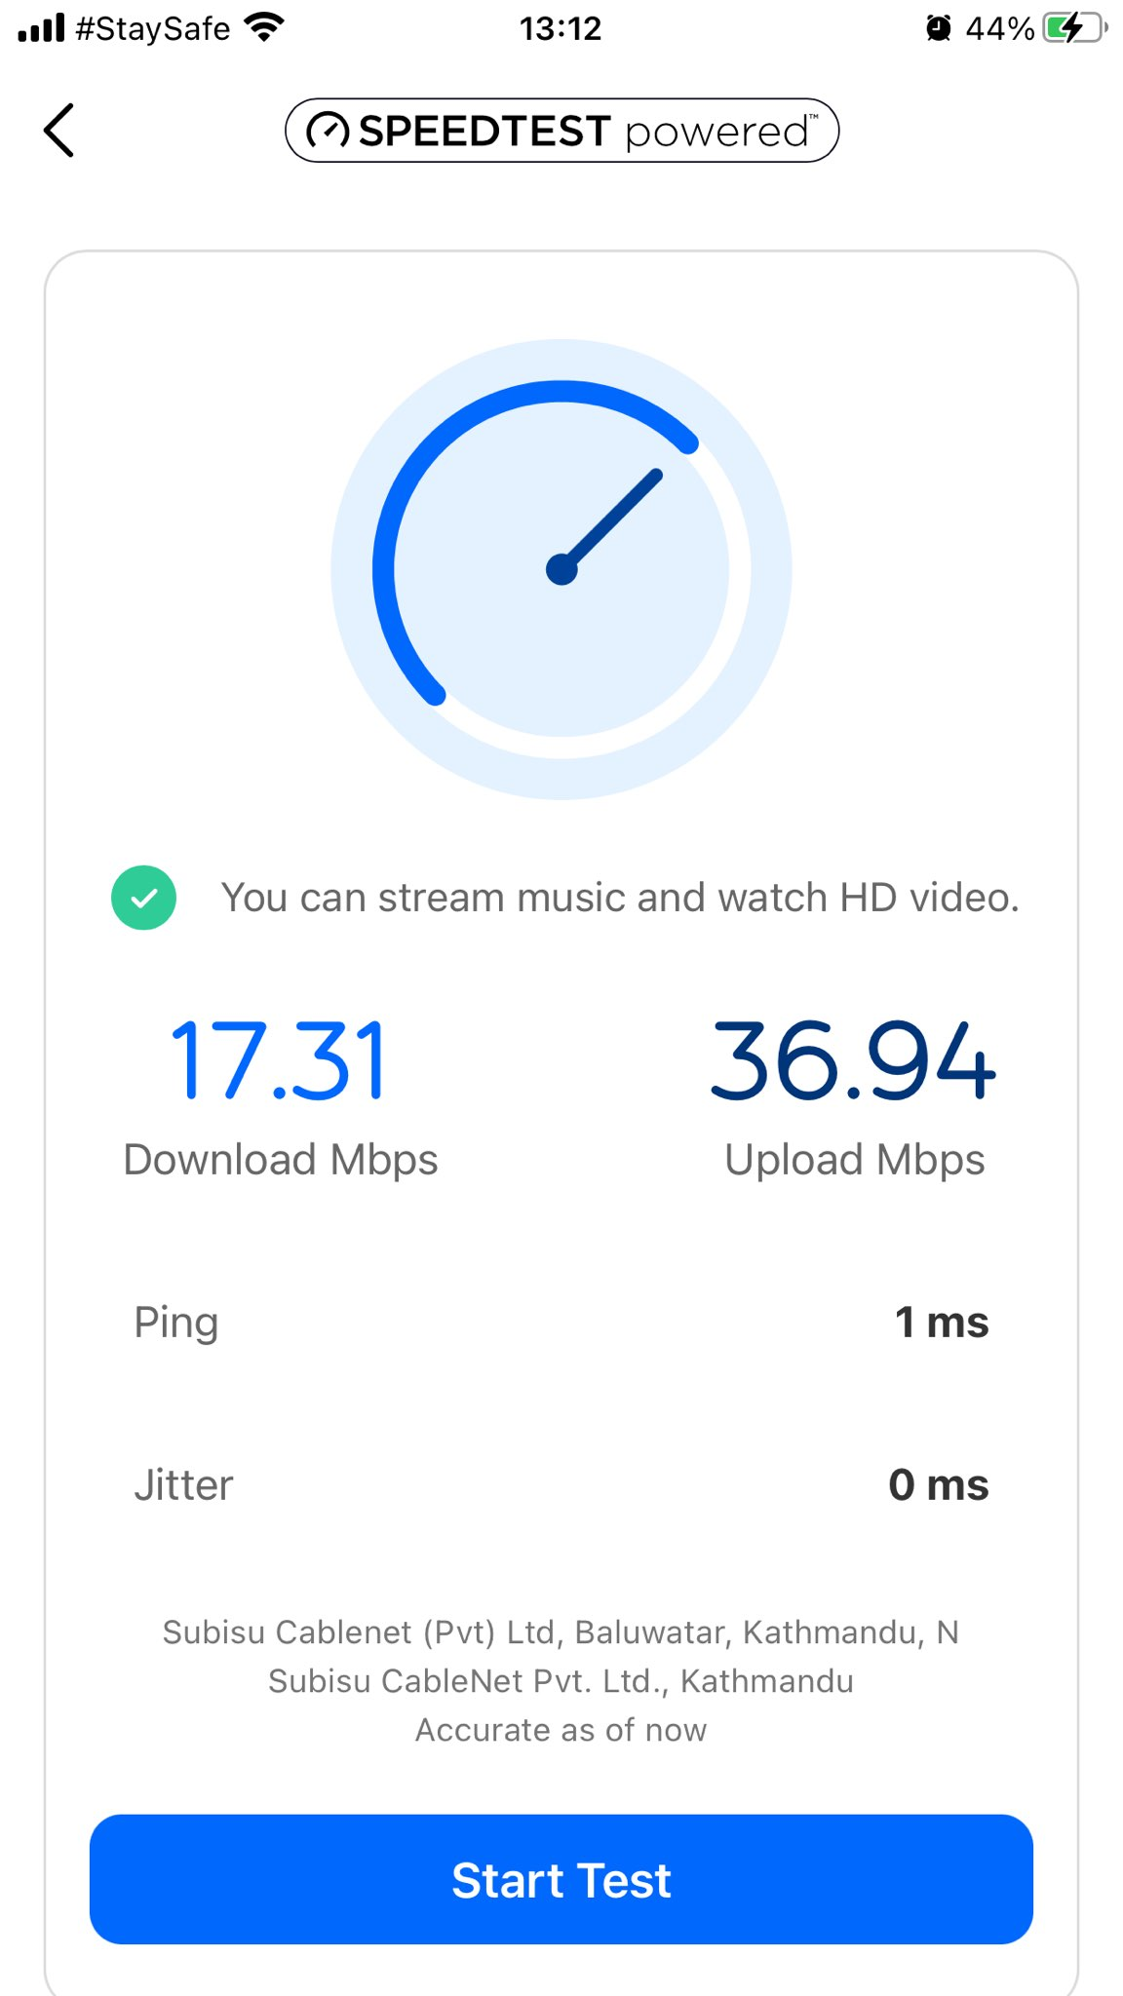
Nokia Recommended Placement
Network Map & Speed test to verify.

Slide 42
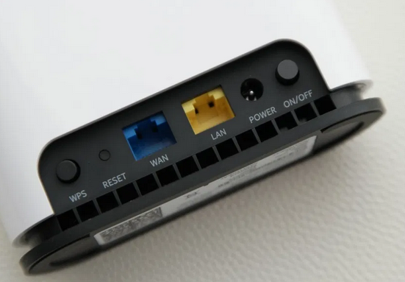
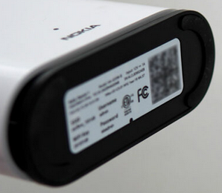
Beacon Installation
PnP Installation
*Step 1: Desktop Mounting with Simple PnP setup.
*Step 2: Power ON and connect WAN Ethernet to ONU/Modem until LED is blue. This setups first beacon as Root device.
*Step 3: First Beacon will act as Root. Once you set as root and associate with account its all set in Nokia Wi-Fi Cloud. *Step 4: Connect another beacon to first beacon via Ethernet same as step 2. This sets wireless mesh after Ethernet is disconnected.
Note : Changing Root later will require factory default setting or de-association with account from Nokia Wi-Fi Cloud via Nokia help Center in app.
Phone App : Nokia Wi-Fi
*Step 1: Use the App to scan the QR code at the bottom of Beacon.
*Step 2: Sign up to see the user friendly setup.

Slide 43
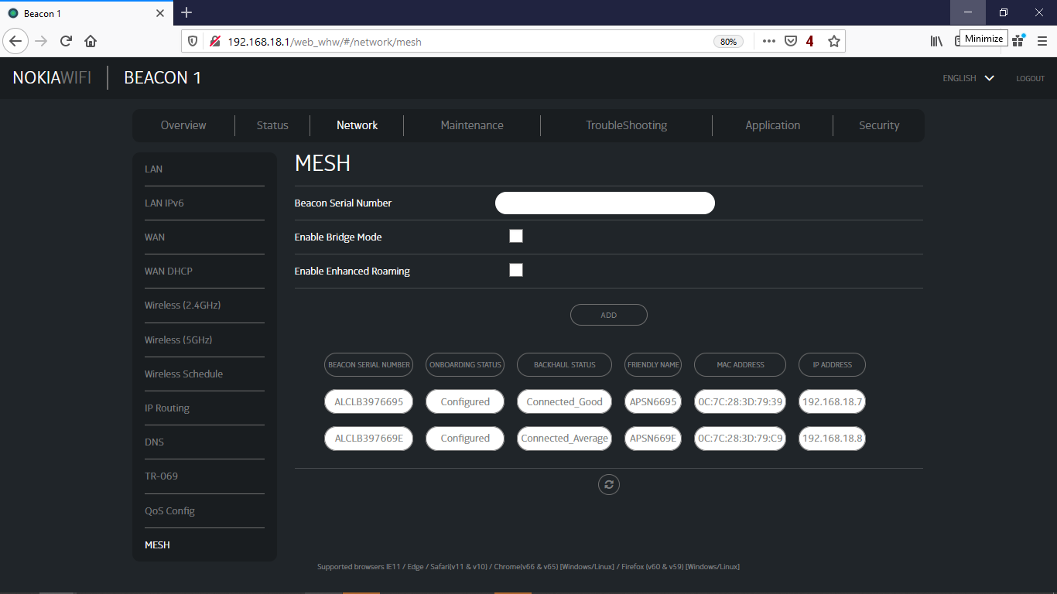

Beacon Installation
Installation from Beacon itself (login to page : 192.168.18.1)

Slide 44



End of Module 3 Thank You !

